Slide 1
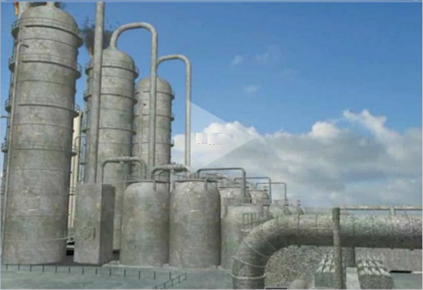
INDUSTRIES

Slide 2
Classification of industries based on
INDUSTRIES
Raw materials
Size
Owner ship
Joint sector industries
Private sector industries
Small scale industries
Large scale industries
Forest based industries
Marine based industries
Agro based industries
Mineral based industries
Co-operative sector industries
Public sector industries

Slide 3
Raw materials
Agro based industries
Mineral based industries
Marine based industries
Forest based industries
They use plants and animals based products as they are raw materials
Examples are: cotton textile, vegetable oil, etc
They are primary industries that use mineral ore as they are raw materials
The products of these industries feed other industries.
Examples are : railway coaches, machinery, etc
They use products from the sea and oceans as raw materials.
Examples are: fish oil, sea food
They utilize forest produce as raw materials.
Examples are:
wax, gum, paper, etc

Slide 4
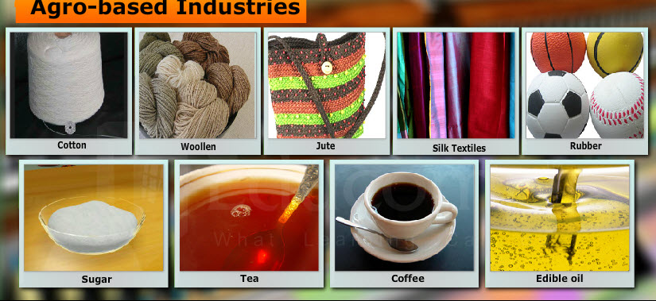
On the basis of raw material

Slide 5
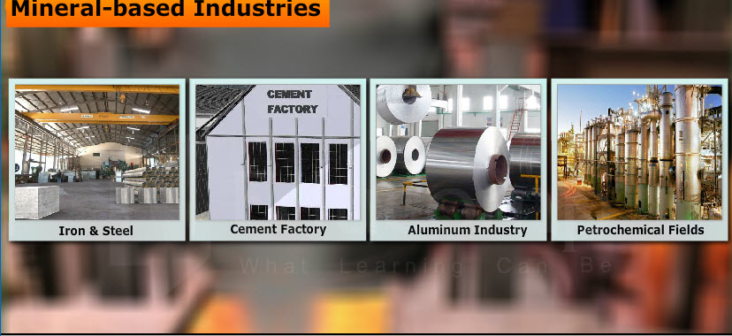
Mineral based industries

Slide 6

Marine based industries

Slide 7
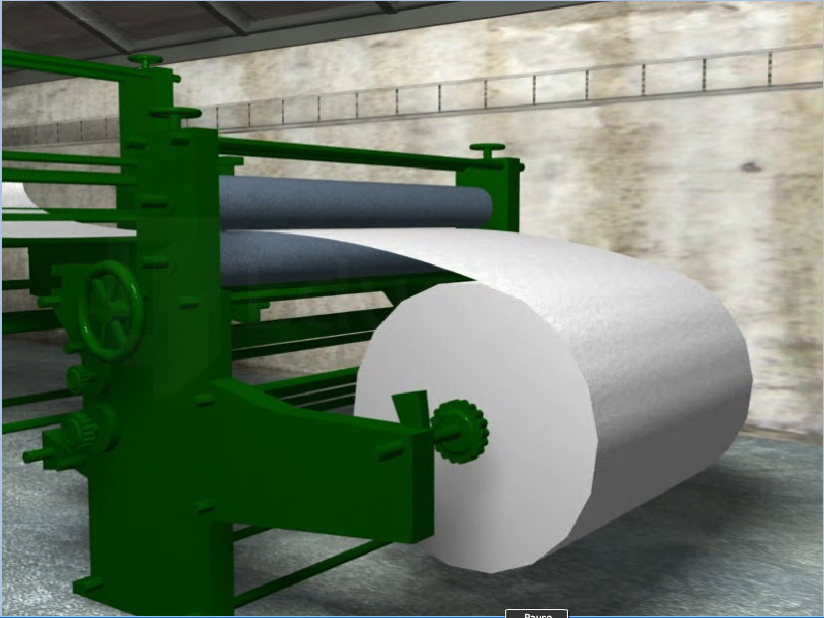
Forest Based Industries
paper

Slide 8
size
Small scale industries
Large scale industries
Type of small scale industries are cottage or house hold
Example of small scale industries are basket weaving, pottery and other handicraft
Small scale industries use lesser amount of capital and technology
Large scale industries produce in large volumes of production
Examples of large scale industries are textile industries, thermal industries
Large scale industries investment of capital is higher ,technology is used more

Slide 9
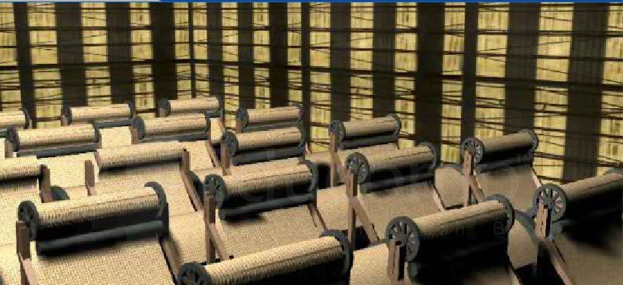
Small scale industries

Slide 10
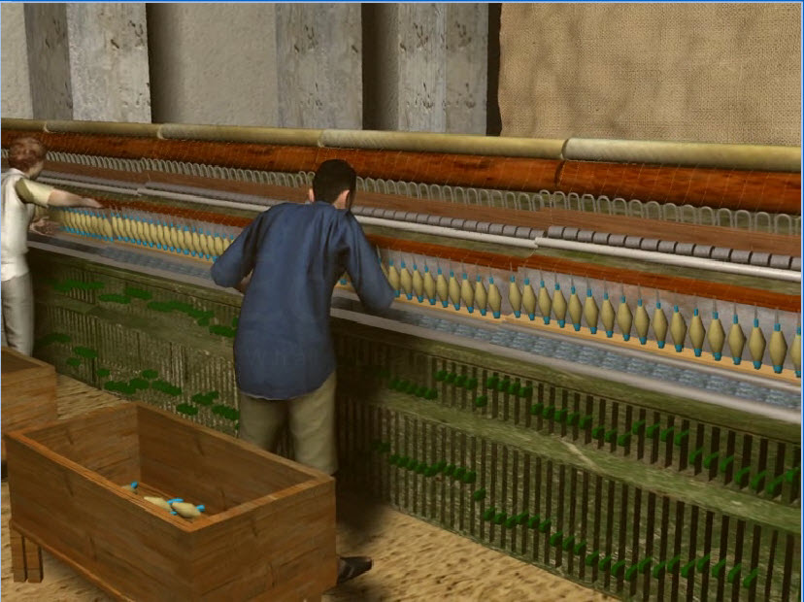
Cottage industries

Slide 11
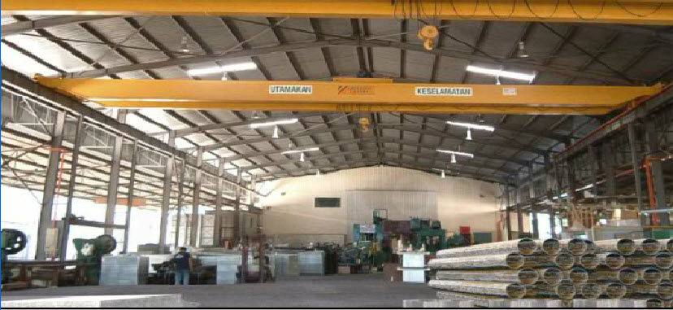
Large scale industries

Slide 12
Private sector industries
Joint sector industries
Co-operative sector industries
Public sector industries
Owner ship
They are owned and operated by individuals or a group of individuals.
They are owned and operated by the state and individuals or a group of individuals.
They are owned and operated by
the government
They are
owned and operated by the producers or suppliers of raw materials, workers or both.

Slide 13

Private sector

Slide 14
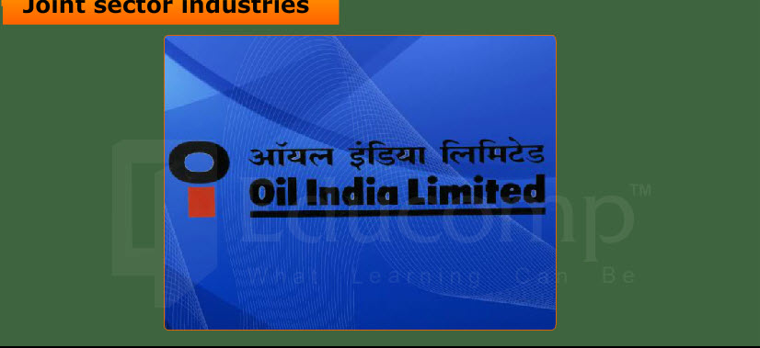
Joint sector

Slide 15
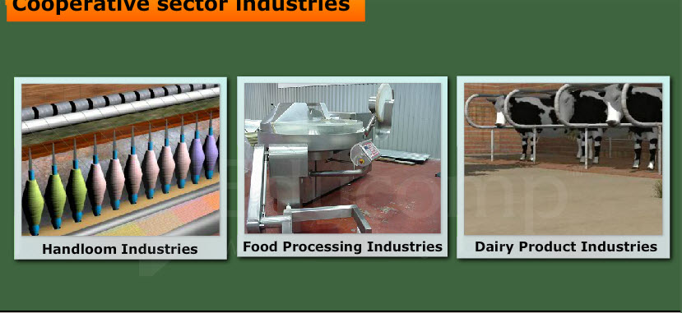
Co-operative sector industries

Slide 16

Public sector industries

Slide 17
Factors needed for industries
Availability of raw material
Land
Water
Labour
Power
Capital
Transport
Market

Slide 18
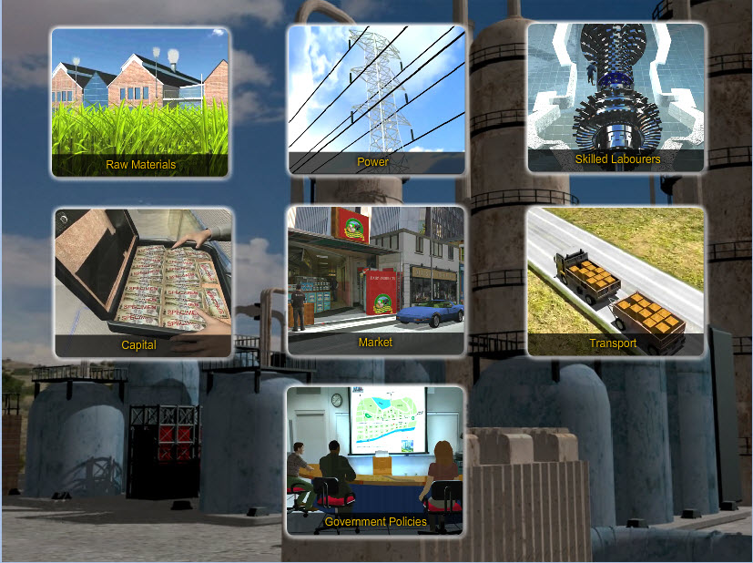
Location factors of industries

Slide 19
Industrial system
input
processes
output
Raw materials
Labour
Transport
Power
Land
Converting raw materials into finished products
End products and income earned in it

Slide 20
Major industries
iron and steel industry
textile industry
information technology

Slide 21
Iron and steel industry
world distribution:
Germany, USA, Japan, Russia and China
Leading producer in the world : USA
Leading producer in India: Jharkhand

Slide 22
Iron and steel
input
processes
output
iron ore
coal
Limestone
labour
Capital
site
converting iron ore into steel
steel which may be used by other industries as raw material.

Slide 23
Iron and steel industry

Slide 24
Textile industry
world distribution: USA, Japan, India, China, Russia
Leading producer in the world: Japan (Osaka)
Leading producer in India: Gujarat (Ahmadabad)

Slide 25
Textile industry
input
processes
output
Cotton
Labour
Factory
Transport system
Ginning
Spinning
Weaving
Dyeing
Printing
Shirt we wear

Slide 26
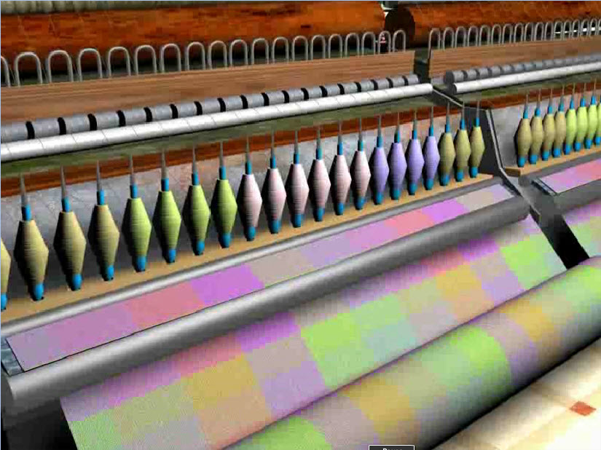

Slide 27
Information technology
Important cities in India:
Mumbai, New Delhi, Hyderabad, Chennai Gurgaon, Pune, Thiruvanthapuram, Kochi
and Chandigarh

Slide 28
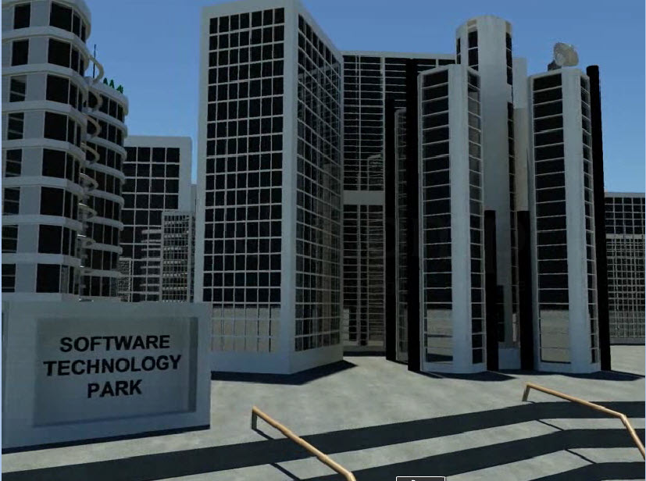
Information technology

Slide 29
Thank You
Now our next topic is Transportation.

Slide 30
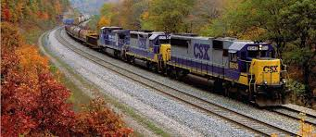
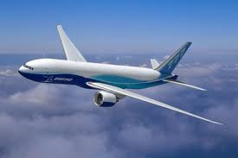
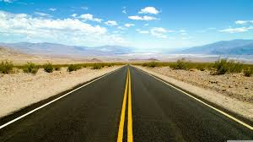
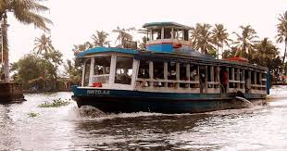
Transportation

Slide 31
Introduction
Transportation is the movement of people, animals or goods from one place to another.
Transportation can be divided into 3 fields:
1.Infrastructure
2.Vehicles
3.Business Operations

Slide 32
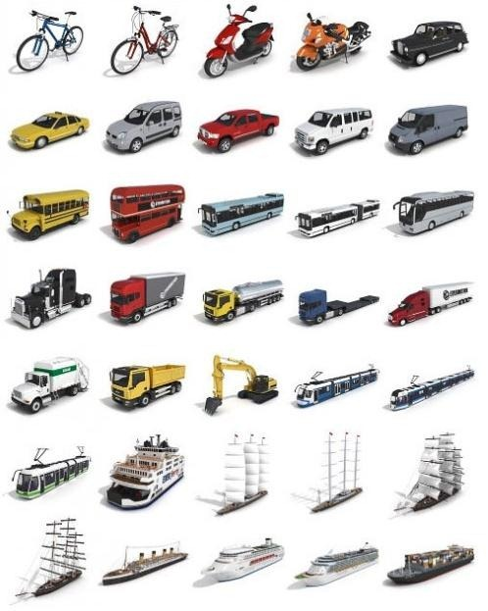
Modes of transport
The Modes of Transport are as follows:
1.Land
2.Air
3.Water
4.Pipelines
5.Ropeways

Slide 33
Factors of transportation
The development of transportation depends upon geographical and economical factors.
Plains have better transportation network than mountainous areas because it is easy to layout tracks and to construct roads on plains.
Cities like Mumbai,Pune,Nagpur,etc. needs well developed transportation.
Industrial Areas like Trombay,Pune-Chinchwad also needs well developed transportation.

Slide 34
Stastictics

Slide 35
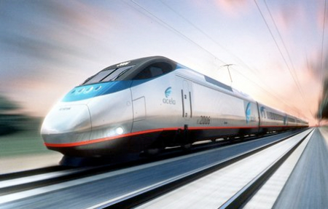
Land transport
Land transportation is transport of people and goods via walking, running, animals or land vehicles.
It is basically divided into 2 types:
1.Roads
2.Railways

Slide 36
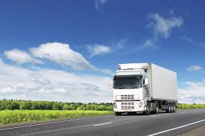
Roads
Roads are one of the oldest methods of transportation.
They are ideal for short distances.
Roads are used by Cars,Bulldozers,Bikes,Rickshaws,etc.
Trucks are used for long distances.
Roads available to the public are referred as highways.

Slide 37
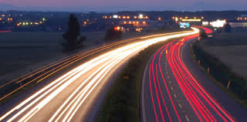
Advantages of Roads
Roads are flexible since they provide door to door service.
Goods can be transported directly from place of production to market for selling or for export.
Good transportation helps in development of communication and tourism.
It is most useful to reach place to provide help during natural calamitites.

Slide 38
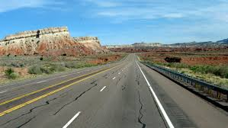
Disadvantages of Roads
They are more expensive then Railways over long distances.
Some areas (Hilly regions) have very poor connectivity.
Due to monsoons, the roads get washed away and they have to be maintained from time to time.
Transportation of heavy and bulky goods is very difficult as well as dangerous.

Slide 39
Types of Roads
Roads
National Highways
State Highways
District Roads
Village Roads

Slide 40
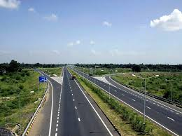
National Highways
National Highways connect important cities of the country. Eg: Mumbai,Delhi,etc.
They are built and maintained by the central government.
National Highways are Identified by Numbers.
For Eg: NH3 runs between Mumbai-Nashik-Agra ,NH17 connects Panvel and Goa and NH8 connects Mumbai and Ahemdabad.

Slide 41
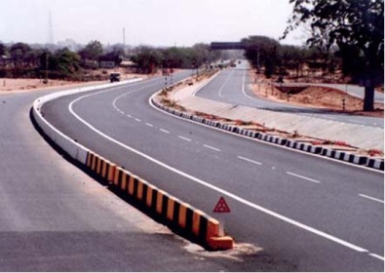
State Highways
State Highways connect important Towns of the State.
They are connected to National Highways and also other important roads.
They are maintained and built by the State Government.
State highways are 4-laned or 6-laned.

Slide 42
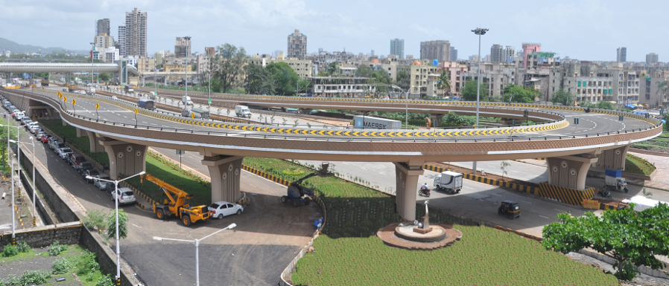
District Roads
District Roads connect different talukas.
They link between state and national highways.
They are linked with them to increase the connectivity.
They are maintained by Zilla Parishad.
They are very important for villagers for reaching their products in the market.

Slide 43
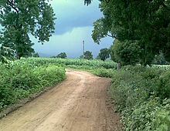
Village Roads
Village roads are maintained by Zilla Parishad.
They are important for accessibility and development of agriculture in rural areas.
Generally the roads are narrow and Kaccha.
But because of the Pradhan Mantri Gram Sadak Yojana (Prime Minister Rural Roads Scheme) , The roads are now developing into all-season and paved asphalt roads.

Slide 44
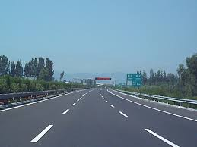
Expressways
There are 2 expressways in Mumbai:
1.Western Express Highway or WEH
->It starts from Mahim and joins up to Dahisar and then joins to NH14.
2.Eastern Express Highway or EEH
-> It starts from Sion and goes to Thane.
-> It is a part of NH3.

Slide 45
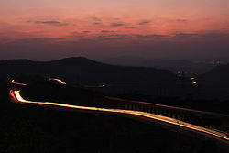
The Mumbai-Pune Super Expressway
It is also known as “Yashvantrao Chavan Expressway”.
It is the only Super Expressway In Maharashtra.
It was India’s First six-lane,concrete,high-speed,access controlled tolled expressway.
The Expressway cost 16.3 Billion rupees (US $260 million) to construct.

Slide 46
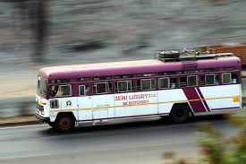
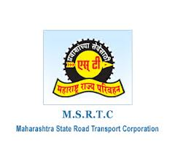
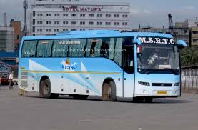
MSRTC
MSRTC Stands for Maharashtra State Road Transport Corporation.
It runs buses popularly known as ST Buses.
It link most of the towns and villages in the state.
MSRTC operates Volvo buses named as “Shivneri” between Major cities like Mumbai,Pune,etc.

Slide 47
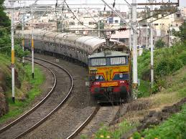
Railways
Railways are one of the most important modes of Land Transportation.
They are very important for the economic development of a region.
They are useful for transportation of goods and passengers over long distances.

Slide 48
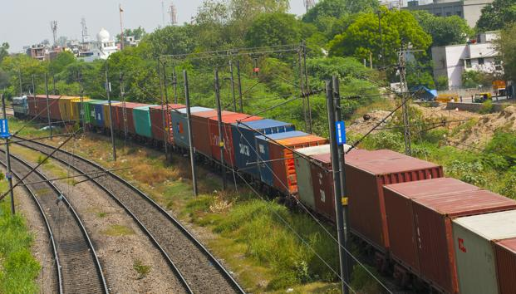
Advantages of Railways
They are much faster and cheaper than roads over long distances.
They are ideal for transporting heavy and bulky goods.
They help in the development of industries and trade.
Travelling by train is very comfortable.
It provides a great scope for employment.

Slide 49
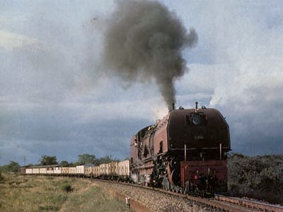
Disadvantages Of Railways
They are not flexible i.e. they cannot provide door to door service.
Construction charges of railways are very high.
In mountainous areas, it is difficult to construct railways.
Its routes and timings cannot be adjusted to individual requirements.
Railways cannot be operated economically in rural areas.

Slide 50
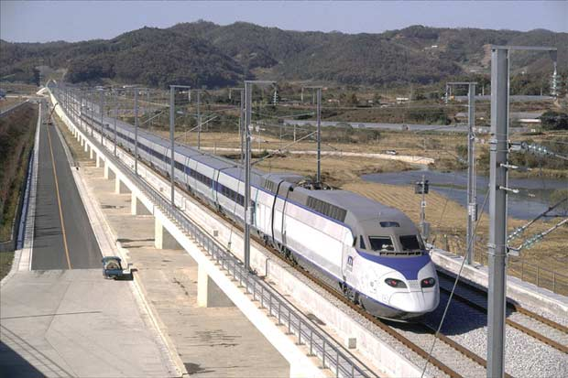
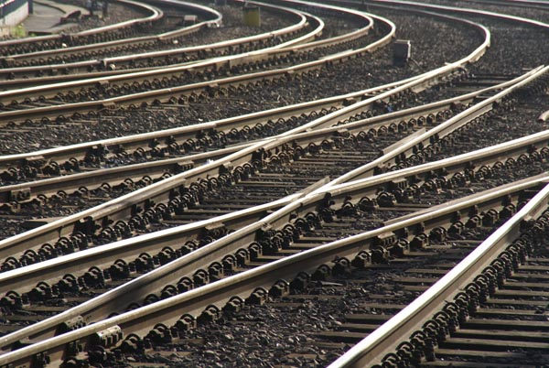
Types of Railways
Railways
Local
Metro
Monorail
Suburban
Railways
Long Distance

Slide 51
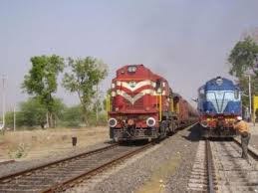
Long Distance Railway
Mumbai is the headquarters of central and western railways.
In Maharashtra,railways are not equally distributed due to its topography.
Some of the main railway routes are:
1.Mumbai to Kolkata
2.Mumbai to Delhi
3.Pune-Miraj-Bengaluru

Slide 52
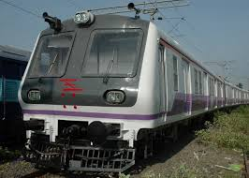
Suburban (Mumbai Metropolitan)
Mumbai Metropolitan has a very high density of population that is why local trains are necessary here.
Mumbai Metropolitan has developed 3 locals:
->Western
->Central
->Harbour
These are very efficient.

Slide 53
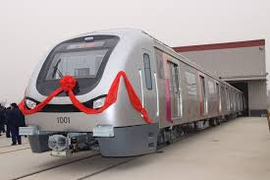

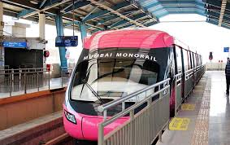

Metro/Monorail
Metro is a type of train where lines can be changed whereas monorail can’t change lines.
This is brought to reduce traffic congestion on the road as well as on the suburban railway.
Line 1 of Mumbai metro was started on 8 June,2014 and Phase 1 of Monorail was operational on 2 February,2014.

Slide 54
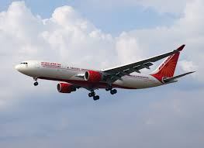
Air Transportation
A method of transport by which passengers and cargo are conveyed through air.
Air transport began to start in America and Europe during World War 1.
The first commercial aviation in India took place from Allahabad to Naini in 1911.
Juhu Aerodrome was India’s first airport.

Slide 55
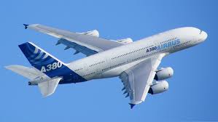
Advantages of Airways
Air transport is the fastest mode of transport.
Planes can fly using shortest and straight route.
It is very useful for trade of light weight and perishable but expensive commodities like fruits,vegtables,flowers,medicines,etc.
Tourism also develops if Air Transportation is well developed.
It emits less poisonous gases than land transport.

Slide 56

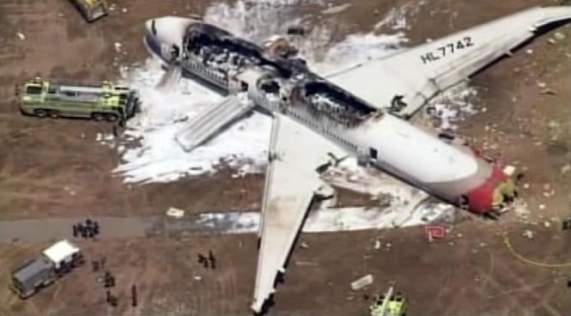
Disadvantages of Airways
It is very expensive so common man cannot afford it.
It has very low carrying capacity.
It needs equipped and very secure airports, so construction charges becomes very high.
Consumption of high quality fuel is necessary.
Air transport needs high qualified workers.
It is the most riskiest mode of transport.

Slide 57
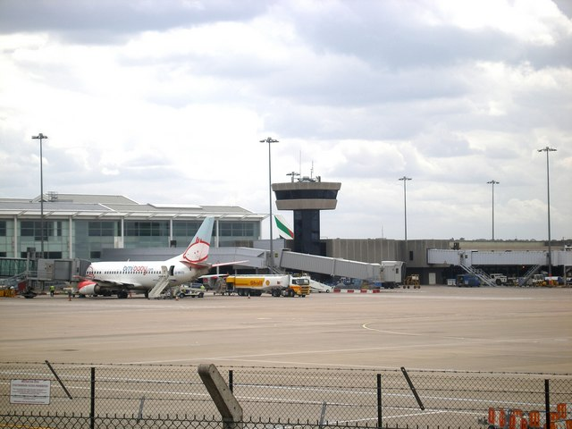
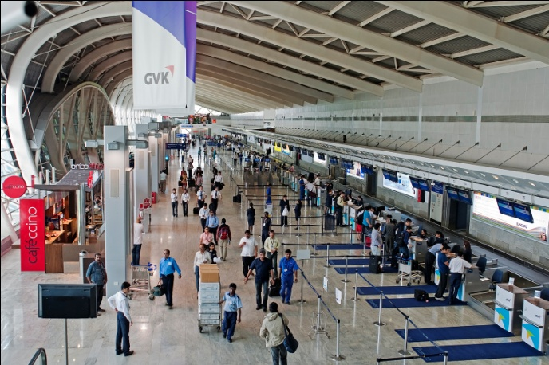
Distribution
Airports
Domestic
Nanded
Karad
International
Mumbai
Pune
Nagpur
Aurangabad
Ratnagiri
Washim
Akola

Slide 58
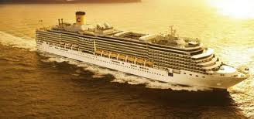
Water Transportation
Water transportation is also an important mode of transport.
There are 2 types of waterways:
Water Transport
Oceanic
Inland
Oceanic
Inland
Waterways

Slide 59
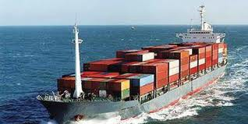
Advantages of Waterways
There is no need to construct roads or to layout railway tracks.
Since they are natural highways,therefore it is the cheapest mode of transportation.
Ships have less friction due to which consumption of energy is less.
It can carry large amount of bulky goods.

Slide 60
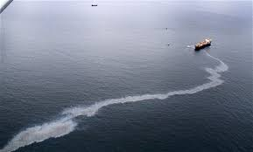
Disadvantages of Waterways
Speed of water transport is very slow.
Ships have to be maintained from time to time.
It can be used in a limited area which is served by deep canals and rivers.
It is unsuitable for small business as it takes more time to reach that product into the market.

Slide 61
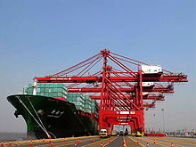
Major ports of Maharashtra
Mumbai Port:
->One of the best and safe harbors in the world.
->Lot of import and export takes place here.
->Many Big Ships from all over the world anchors here.
Jawaharlal Nehru Port:
->Most Modern Port of India.
->Highly mechanized port and work is done by machines with limited labour force.

Slide 62
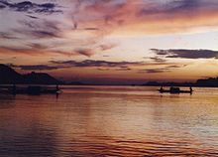
Inland Waterways
The rivers of Maharashtra are rain-fed and because of that they dry up during summer.
They are very shallow and due to rough terrain they cannot be used for waterways.
Only at some places, Ferries are used to cross rivers where accessibility is greatly reduced.
There are 6 national waterways in India.

Slide 63
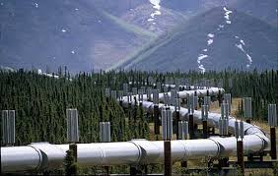
Pipelines
Pipeline Transport is the Transportation of goods through a Pipe.
Generally, products like oil,crude and petroleum products are transported.
More than 6350km of Pipeline exists In India.
Currently 27% of petroleum products are moved by pipelines in India.

Slide 64

Advantages Of Pipelines
Pipeline is a very reliable means of transportation of crude oil and gas from place of production to the place of consumption.
They are suitable for all-weather.
They are flexible i.e. they can be used in the hilly areas or under the sea.
There is no delay in transportation of material.

Slide 65

Disadvantages of Pipelines
Initial costs to layout pipelines are very high.
As it passes through many rural areas,chances of sabotage are very high.
Constant maintenance is required.
If leakage takes place,it can be very dangerous.
It can only carry certain types of Fluid.

Slide 66

Ropeways
Ropeway is a system of overhead ropes on which carriers (cabins) are used for the purpose of transporting passengers.
They are erected on towers, especially at different terrain.
Currently in India, nearly 178km of ropeways are used for transportation.
Generally they are used for Tourism.
Eg:Ropeways in Matheran.

Slide 67
Thank You
Made By :
1} Ansh Mehta
2} Dhruvil Shah
3} Mohd Ali Shaikh
9-C

